Slide 1
Machine Learning I Regression analysis of Student grade data
Buğra Duman
KaMIL Matuszelański
Notes:
TODO: letters and plots are veeery small – remember that we have shitty comunicator with low resolution

Slide 2
Scope
Description of Dataset
EDA with plots
Feature selection
Models (Linear,Ridge,Lasso,KNN)

Slide 3
MAth FINAL GRADE
Father Education
Failures
Traveltime
Studytime
Weekday Alcohol consumption
Weekend Alcohol consumption
Parent Status
Romantic
Absences
Final Grade
Go out
Family relation
Guardion
Mother Job
Father Job
Sex
Age
Notes:
TODO: change names of variables for readable ones – e.g. walc to weekend alcohol consumption – this will be clearer if sbd will just read
The data were obtained in a survey of students math and portuguese language courses in secondary school. It contains a lot of interesting social, gender and study information about students.
school - student's school (binary: 'GP' - Gabriel Pereira or 'MS' - Mousinho da Silveira) sex - student's sex (binary: 'F' - female or 'M' - male) age - student's age (numeric: from 15 to 22) address - student's home address type (binary: 'U' - urban or 'R' - rural) famsize - family size (binary: 'LE3' - less or equal to 3 or 'GT3' - greater than 3) Pstatus - parent's cohabitation status (binary: 'T' - living together or 'A' - apart) Medu - mother's education (numeric: 0 - none, 1 - primary education (4th grade), 2 – 5th to 9th grade, 3 – secondary education or 4 – higher education) Fedu - father's education (numeric: 0 - none, 1 - primary education (4th grade), 2 – 5th to 9th grade, 3 – secondary education or 4 – higher education) Mjob - mother's job (nominal: 'teacher', 'health' care related, civil 'services' (e.g. administrative or police), 'at_home' or 'other') Fjob - father's job (nominal: 'teacher', 'health' care related, civil 'services' (e.g. administrative or police), 'at_home' or 'other') reason - reason to choose this school (nominal: close to 'home', school 'reputation', 'course' preference or 'other') guardian - student's guardian (nominal: 'mother', 'father' or 'other') traveltime - home to school travel time (numeric: 1 - 1 hour) studytime - weekly study time (numeric: 1 - 10 hours) failures - number of past class failures (numeric: n if 1<=n<3, else 4) schoolsup - extra educational support (binary: yes or no) famsup - family educational support (binary: yes or no) paid - extra paid classes within the course subject (Math or Portuguese) (binary: yes or no) activities - extra-curricular activities (binary: yes or no) nursery - attended nursery school (binary: yes or no) higher - wants to take higher education (binary: yes or no) internet - Internet access at home (binary: yes or no) romantic - with a romantic relationship (binary: yes or no) famrel - quality of family relationships (numeric: from 1 - very bad to 5 - excellent) freetime - free time after school (numeric: from 1 - very low to 5 - very high) goout - going out with friends (numeric: from 1 - very low to 5 - very high) Dalc - workday alcohol consumption (numeric: from 1 - very low to 5 - very high) Walc - weekend alcohol consumption (numeric: from 1 - very low to 5 - very high) health - current health status (numeric: from 1 - very bad to 5 - very good) absences - number of school absences (numeric: from 0 to 93) G1 - first period grade (numeric: from 0 to 20) G2 - second period grade (numeric: from 0 to 20) G3 - final grade (numeric: from 0 to 20, output target)

Slide 4


FEatures
Notes:
Mention no NAs

Slide 5
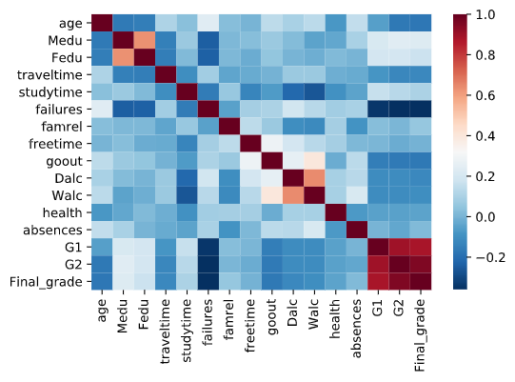
plots
Correlation matrix based on Spearman
Notes:
TODO: maybe put one plot on one slide? Now these are very small and labels not visible at all
There are lots of columns so lets create a subset of data based on heatmap.

Slide 6
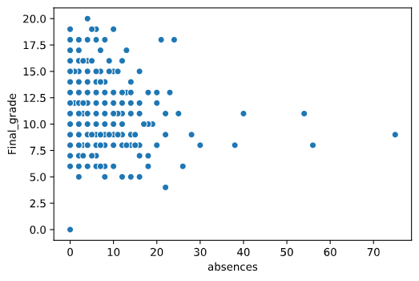
plots
Notes:
TODO: maybe put one plot on one slide? Now these are very small and labels not visible at all
There are lots of columns so lets create a subset of data based on heatmap.

Slide 7
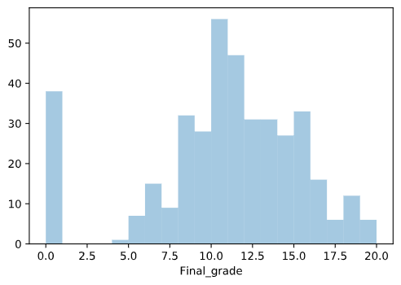
plots
Notes:
When showing the histogram with final grade, please mention that there are lots of 0s and not many below 5 - important for me when talking about hurdle model

Slide 8
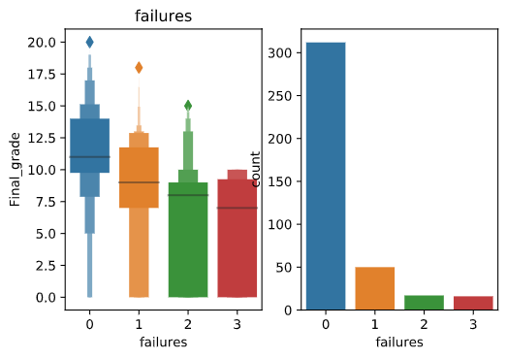
plots
Notes:
When showing the histogram with final grade, please mention that there are lots of 0s and not many below 5 - important for me when talking about hurdle model

Slide 9
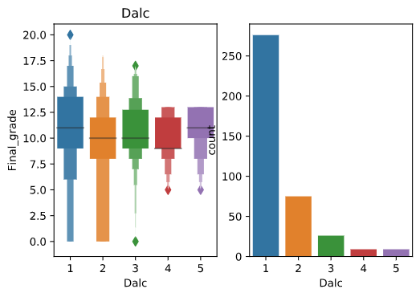
plots

Slide 10
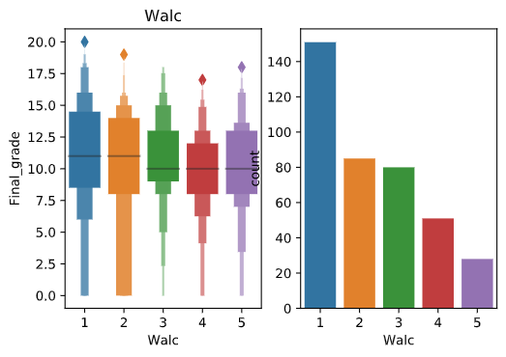
plots

Slide 11
Methods
Linear model
SVM
KNN
Ridge and Lasso
Hurdle
Notes:
Add hurdle

Slide 12
Linear Model
With all features
R2 train: 0.24
R2 test: 0.06
Overfitting
Notes:
Round the scores, remove MAE (or even RMSE? dunno)
That slide is very off actually

Slide 13
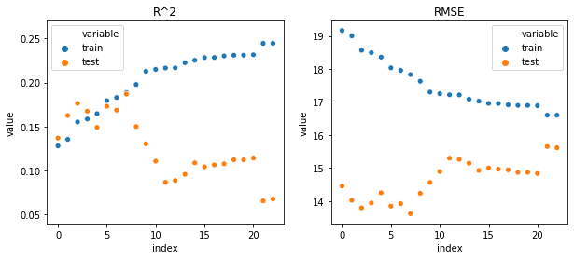
Fıghting with overfitting – rfe
R2 train: 0.1886
R2 test: 0.1868
Notes:
Plot larger, one score (R2?), round the scores
Scores with best alpha at 10

Slide 14
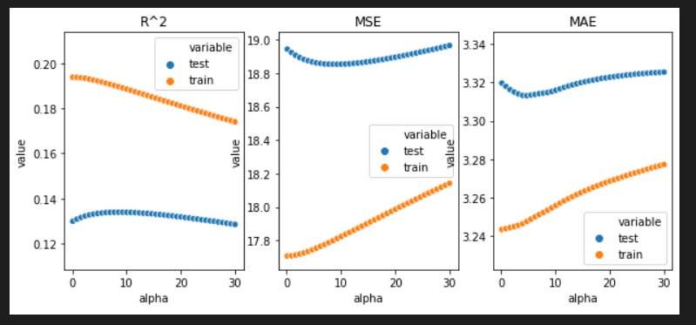
Fıghting with overfitting -Ridge
R2 train: 0.184
R2 test: 0.195
Notes:
Plot larger, one score (R2?), round the scores
Scores with best alpha at 10

Slide 15
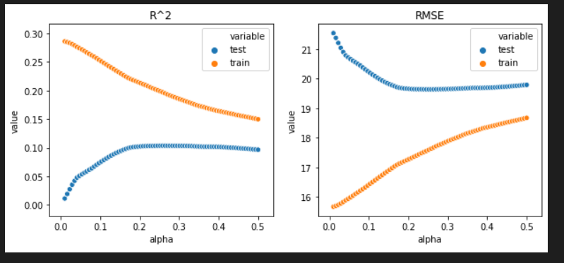
Fıghting with overfitting -Lasso
R2 train: 0.182
R2 test: 0.100
Notes:
Same as ridge
Scores with best alpha at 10

Slide 16
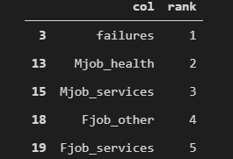
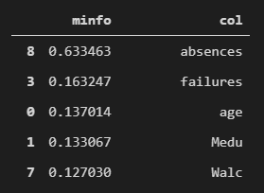
Feature Selectıon
RFE
Mutual Info
Notes:
TODO: Copy the table contents, not the photo – to keep the same font

Slide 17
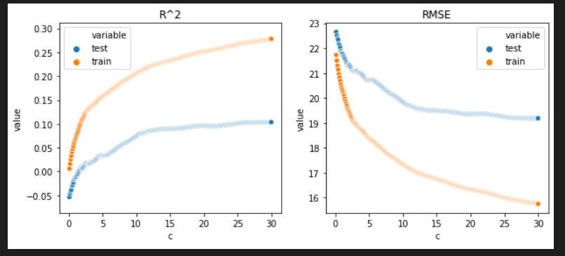
SVM
R2 train: 0.2270
R2 test: 0.1984

Slide 18
Model Comparison

Slide 19
Conclusions
Our Fails
KNN
SVM with features from linear model
Linear model with mutual information features
General take-aways
R^2 around 20% is very poor
SVM was the best model, with Ridge being almost as good

